Slide 1
ASU Capstone Project - Fab Escape
Edgar Espinal
Digital Creative Producer
Instructional Development

Slide 2
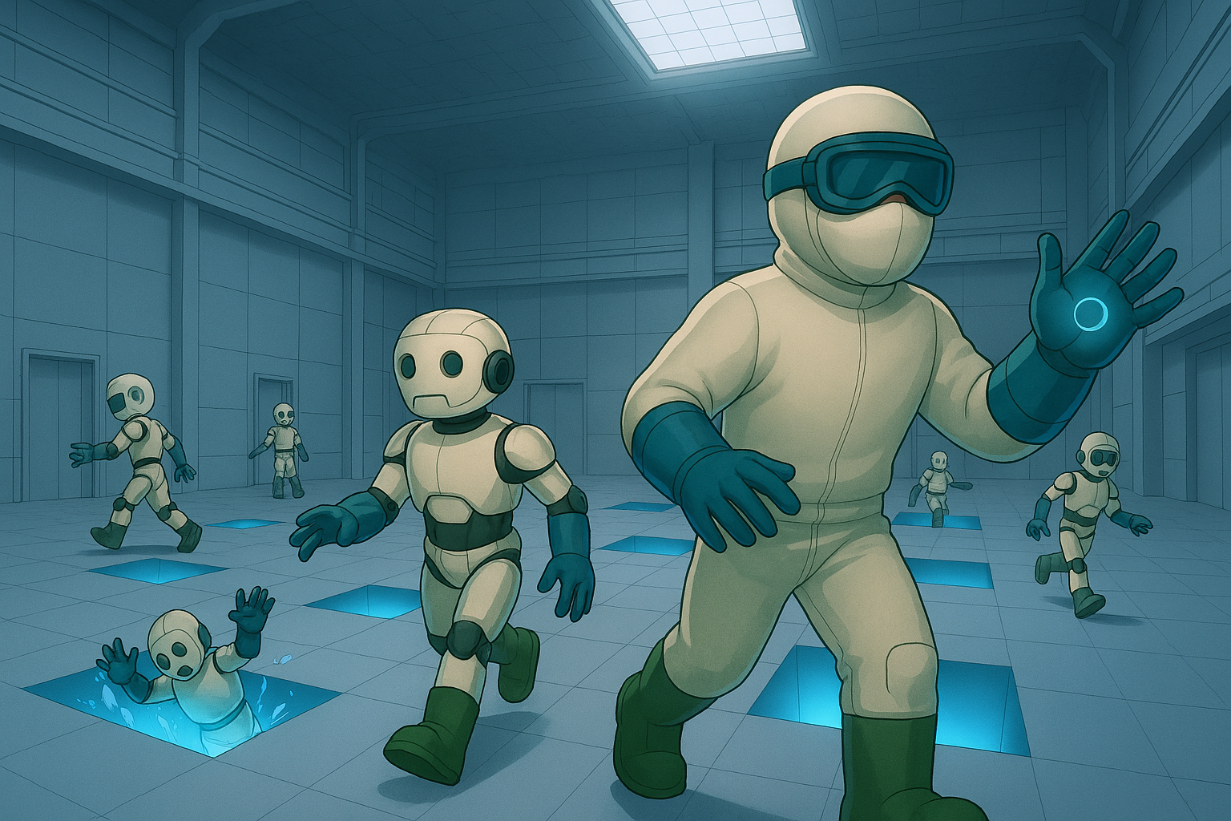

Slide 3

Concept
Step into the boots of Marcus Shepard, a Field Service Engineer in a high-stakes semiconductor fab. In this immersive VR experience, guide robot NPCs to safety using barricades and strategic power-ups while avoiding deadly floor gaps. Face electrified and toxic threats in timed puzzle levels where de-energizing circuit boards is the key to survival. Earn points, unlock advanced PPE, and climb the leaderboard, just don’t fall in, or it’s GAME OVER.

Slide 4
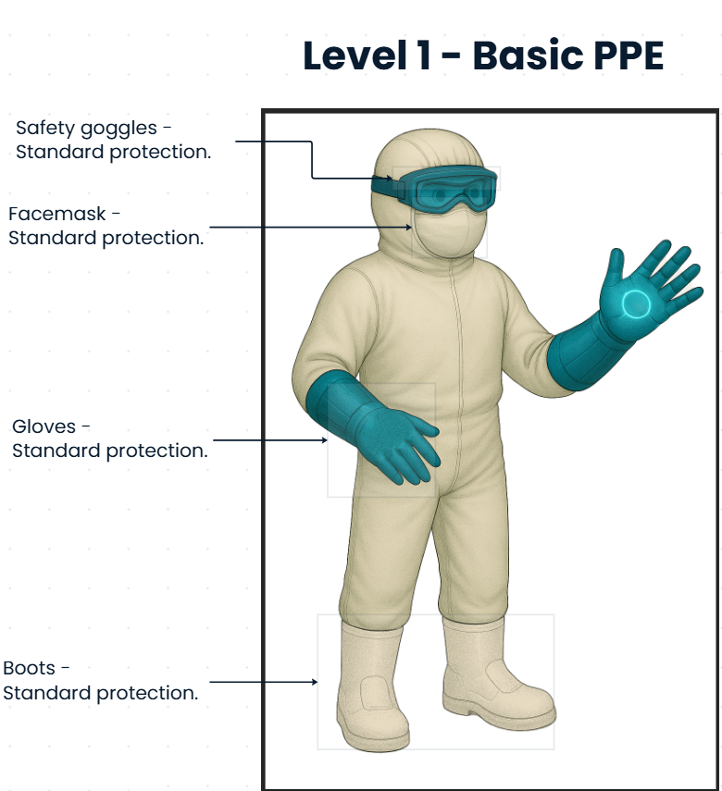
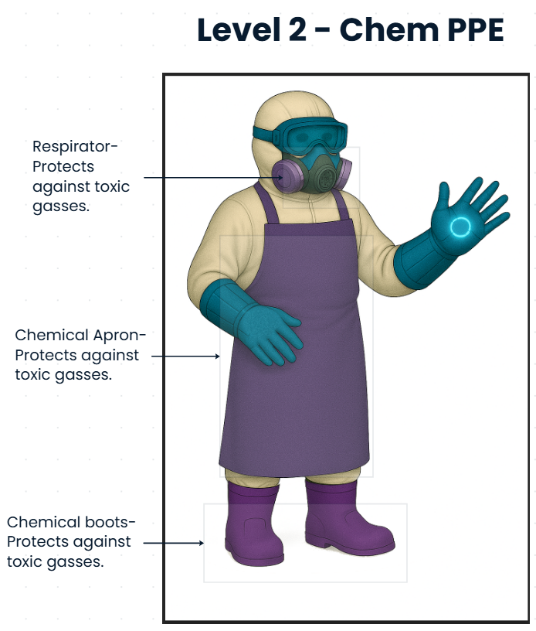
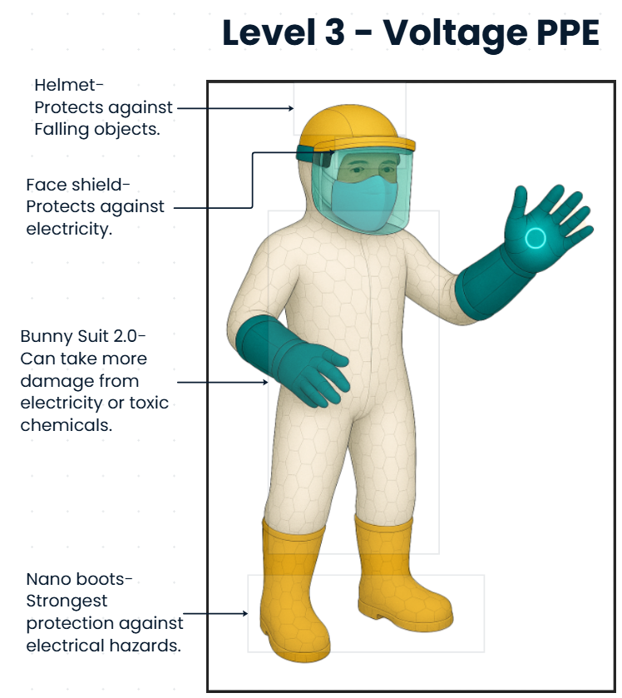
Main character – FSE Marcus Shepard

Slide 5
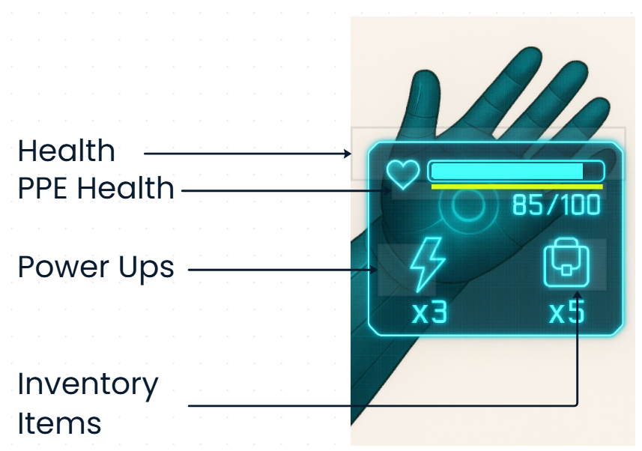
Player in-game UI

Slide 6
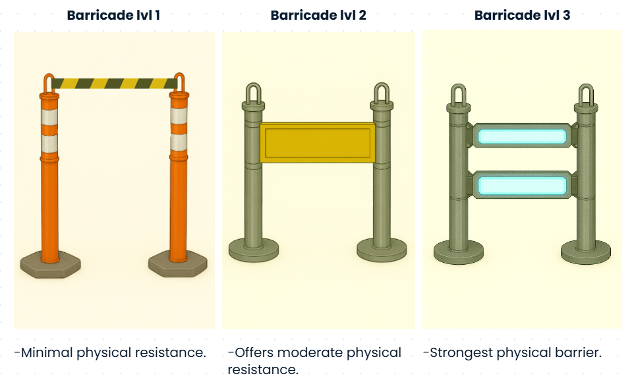
Inventory Items

Slide 7
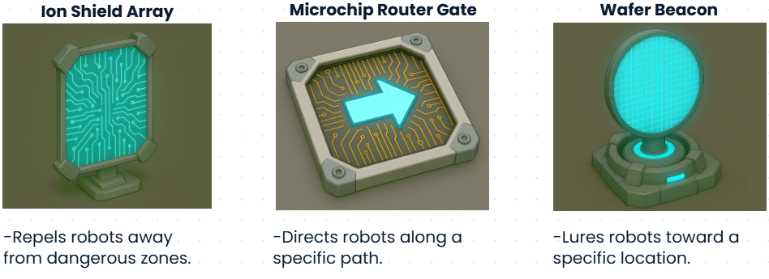
Power Ups

Slide 8
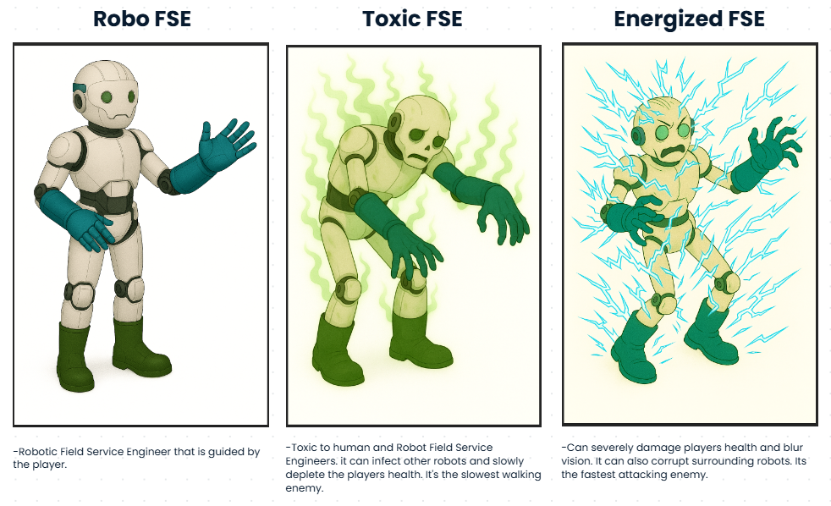
Enemies

Slide 9
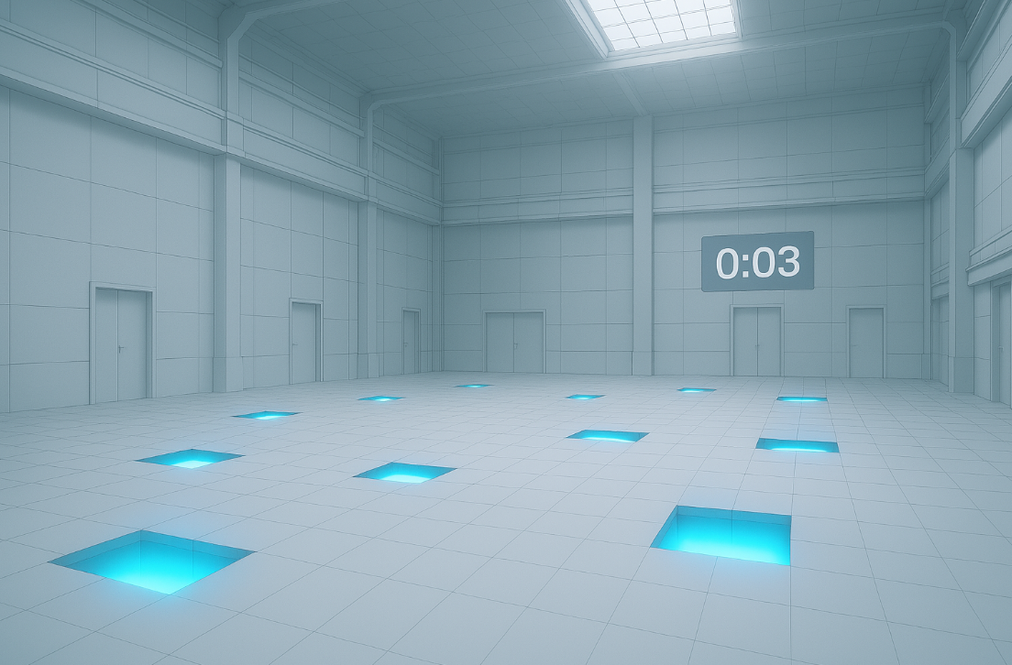
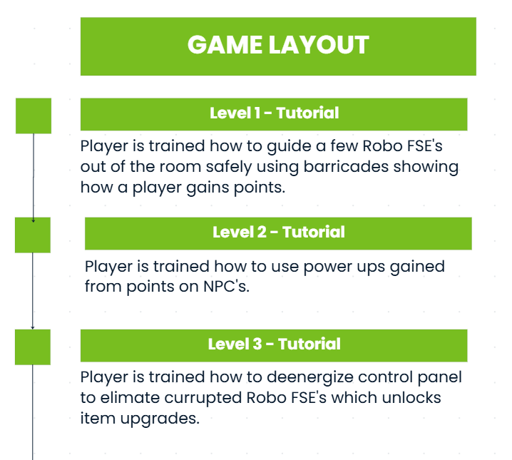
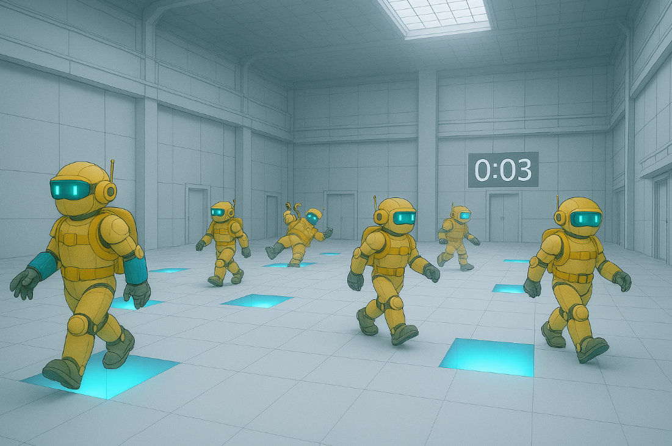
Level – Tutorials 01

Slide 10
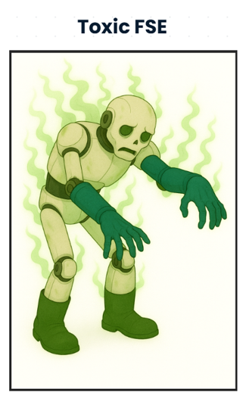
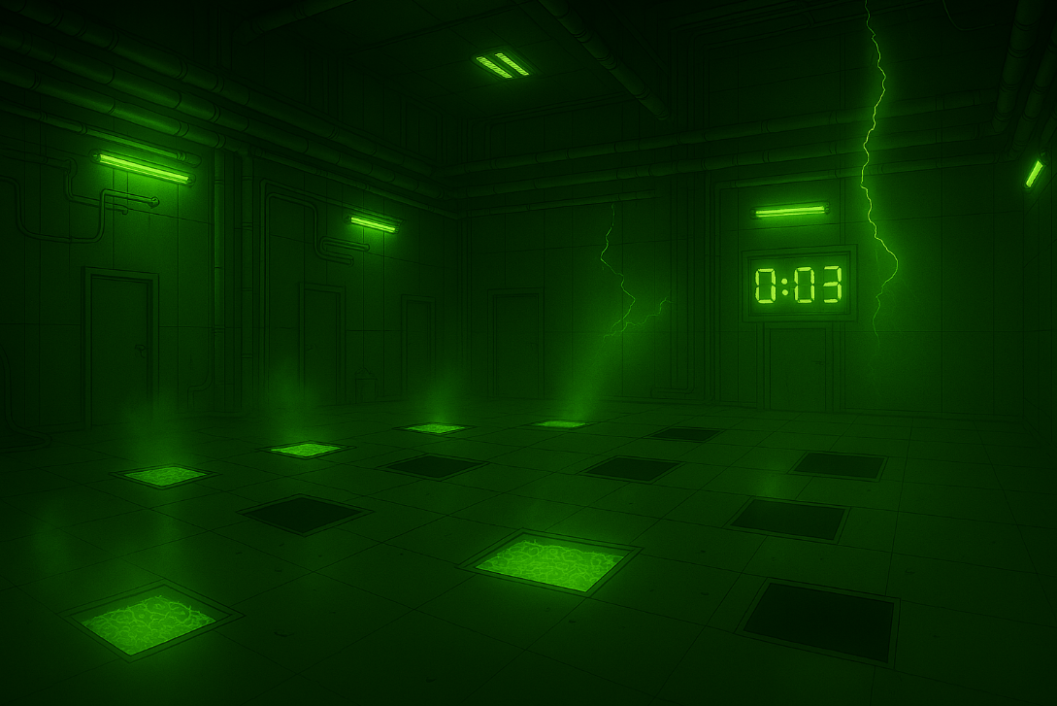
Level - Challenge 02
Deenergize enemy and avoid toxic gases and fluids.

Slide 11
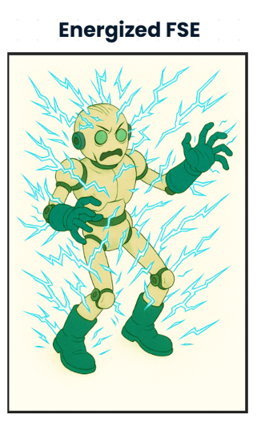
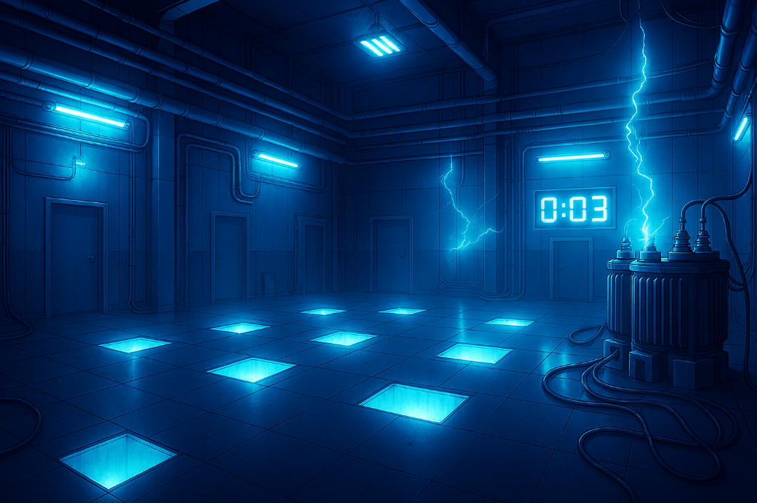
Level – Challenge 03
Deenergize enemy and avoid electric sparks and falling objects.

Slide 12
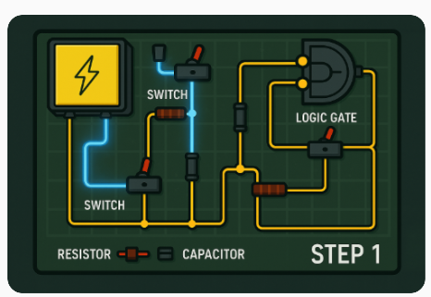

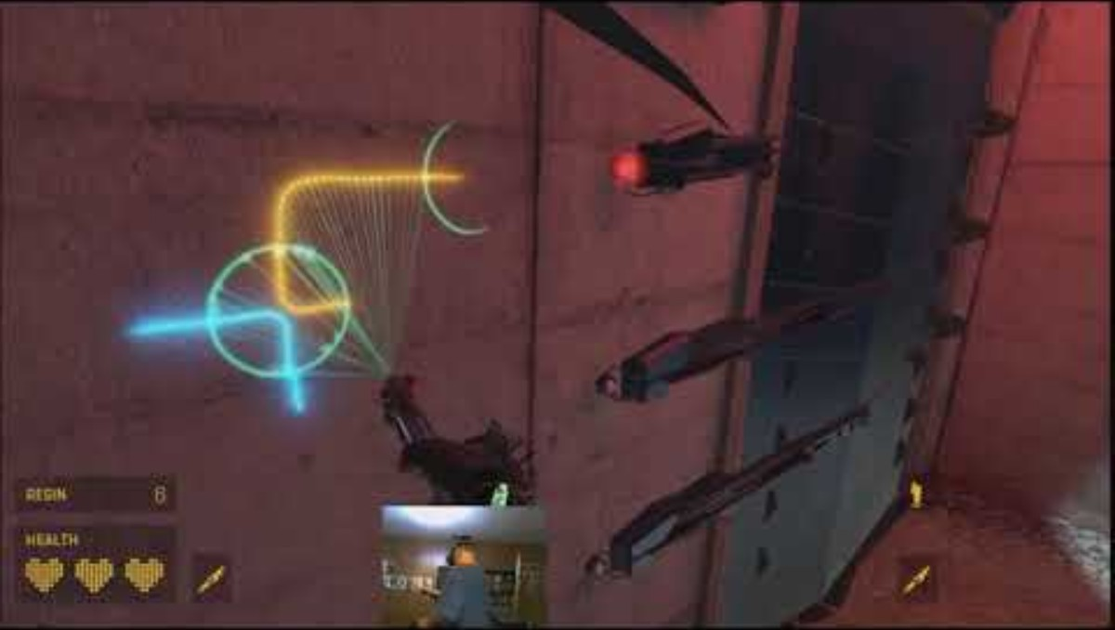
Puzzle – Deenergize enemies
Control Panel
Circuit Board
Inspiration – Half Life Alyx
Concept
The circuit board has current flowing to a battery. The player needs to change the flow of the electrical current to a designated spot on the board to deenergize the control panel and turn off enemy bots.

Slide 13
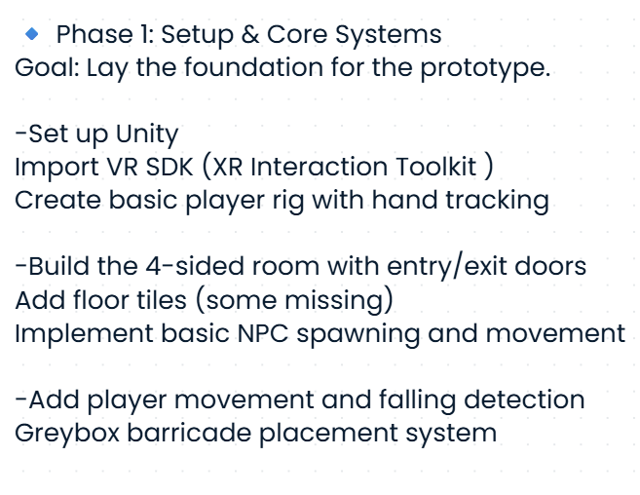
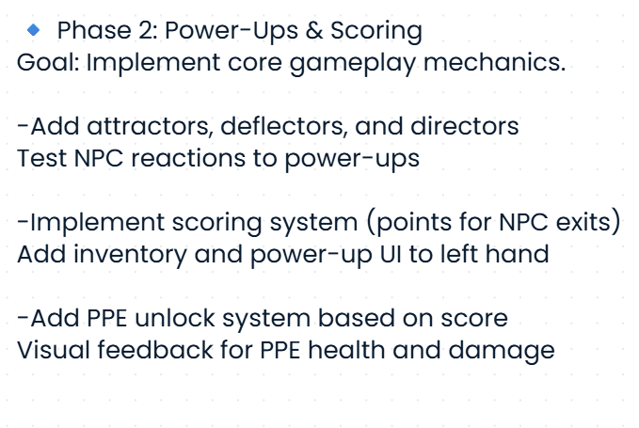
Prototype Sprint – Oct 17th – Nov 6th

Slide 14
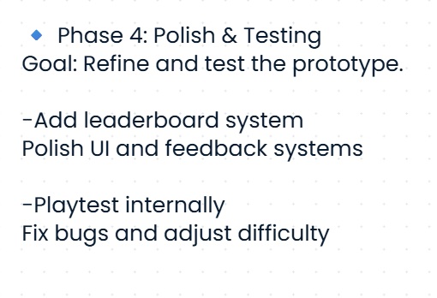
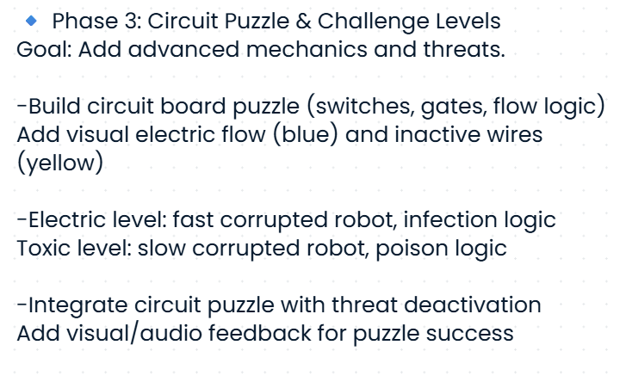
Prototype Sprint – Oct 17th – Nov 6th

Slide 15
Helpful tutorials and information
Scoring logic
A central script (for example, a ScoreManager) that tracks points and updates them based on in-game events, such as adding points when NPCs exit safely and subtracting them when they fall. A good starting point should be our “Add a scoring system” tutorial here: Link
2. Level timer
Use a coroutine or Time.deltaTime (Link) to handle countdowns and trigger the end of a level when time expires.
3. Unlockables and progression
Link the player’s accumulated score to item or power-up unlocks by checking score thresholds within a progression or inventory manager script.
4. Leaderboards
For online leaderboards, Unity Gaming Services provides a managed solution with ranking and player authentication: Link
If you prefer an offline setup, you can save and load scores locally using PlayerPrefs, JSON files, or a ScriptableObject to hold high-score data. ScriptableObjects are a good choice for local leaderboards because they keep your data persistent and easy to edit directly in the Editor.
5. Learning resources
These guides walk through practical examples of scoring and progression systems:Link
GameDev Beginner(Unofficial): How to keep score in Unity: Link

